Slide 1
Ginnie Mae
Validation & Testing Tool (VTT) Training
For PDD Import Pool Submissions
April 2023
.

Slide 2
Agenda
3
VTT Overview
4
Validation Process
5
Tips for Development
6
Key Resources and Support

Slide 3
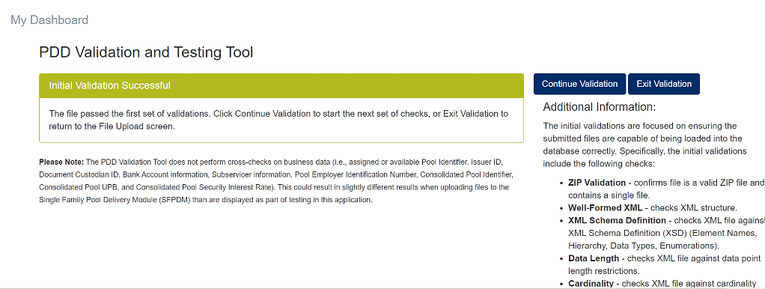
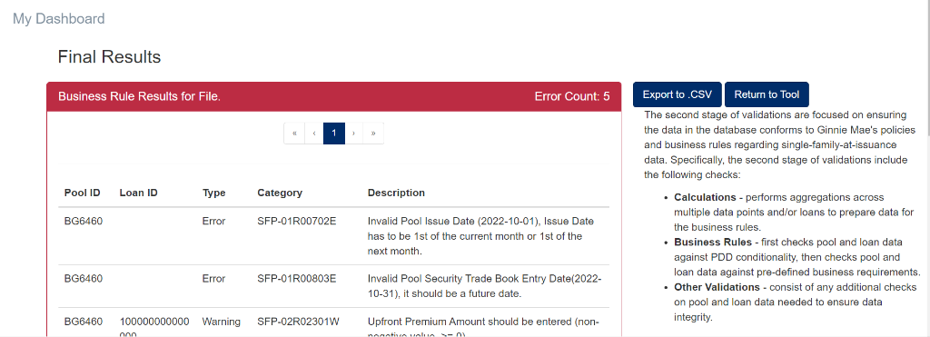
Validation & Testing Tool (VTT) Overview
Purpose
The VTT is available within the MGM portal and is intended for Issuers to test and validate their PDD submission files prior to using SFPDM.
Process
Validations are performed via a two-step process:
Structural validations verify XML file structure and data formats
Business Rule validations validate the file’s adherence to Ginnie Mae’s Business Rules.
Access
All Issuers that currently submit Single Family Pools should already have access to the VTT and SFPDM.
3

Slide 4
VTT Validation Process
1
2a
2b
Structural Validations
Pre-Store & Data Integrity Validations
Business Rule Validations
If a file fails Structural Validations, a 1st Round Error Report will be generated
If a file passes Structural Validations, the user may proceed to generate the 2nd Round Report or exit
Pre-Store & Data Integrity errors may appear in the 2nd Round Report, and some may need to be resolved before some Business Rule Errors can appear in the 2nd Round Report
If a file fails Business Rule Validations, a 2nd Round Error Report will be generated
If a file passes Business Rule Validations, a Successful 2nd Round Report will be generated
The value ({poolMaturityDate}) of element 'PoolMaturityDate' is not valid
SFP-02A13501E: LTVRatioPercent for loan [Loan ID] cannot be blank
SFP-01R01501E Invalid or missing Pool Tax Payer Identifier ({taxPayerID}), it should be numeric.
Commonly Occurring Errors
The content of element 'DOWN_PAYMENT' is not complete. One of '{"www.ginniemae.gov":FundsType}' is expected
SFP-02A13301E: MortgageProgramType for loan [Loan ID] cannot be blank
SFP-01R00803E Invalid Pool Security Trade Book Entry Date ({tradebookDate}), it should be current date or future date
4

Slide 5
VTT Tips for Development
Editing an XML file with the Notepad or WordPad applications may change the encoding to UTF-8 BOM
Many of the date data points within the PDD are expected to reflect a pool that is being submitted today – files with older dates will encounter Business Rule Errors
All users that currently submit SF pools have access to the VTT. Vendors can request access via askGinnieMae@hud.gov ​
File Encoding Type (UTF-8)
Use UTF-8 encoding when declaring the encoding in the file header AND when saving the file. Do not use UTF-8 BOM encoding as this will cause import errors in SFPDM
Date Data Points
Access to VTT
5

Slide 6
Key Resources and Support
The following resources are available on GinnieMae.gov under Issuer Training:
PDD
Modernization Initiatives → SFPDM-MISMO®
PDD Implementation Guide
PDD Quick Guides
FAQs
PDD / ULDD Common Data Points
Ginnie Mae Customer Support
Dial 1-833-466-2435
PDD / VTT Support: Select 3 then 6
SFPDM Support: Select 1 then 1
​
SFPDM
Tools and Resources → User Manuals
SFPDM User Manual
Tools and Resources → Other Aids
Business Rules and Errors Guide
SFPDM Training Recording
Training Recordings → Systems and Applications
VTT
Tools and Resources → User Manuals
PDD / VTT Support Mailbox
VTT User Manual
GinnieMae_MISMO_Support@hud.gov
Training Recordings → Systems and Applications
SFPDM Support Mailbox
VTT Training Recording
askGinnieMae@hud.gov
Announcements → QRCs
VTT Quick Reference Card
6

